Slide 1
National Leadership Council (NLC)
October 2019
Notes:
• The following is a overview of the discussions
and feedback from the conference calls held
from January – September 2019 by Rich
Thomas and Jim Walker (NLC officers) with
State Council Chairs and NLC
Representatives as well as NLC Workgroup
Chairs.

Slide 2
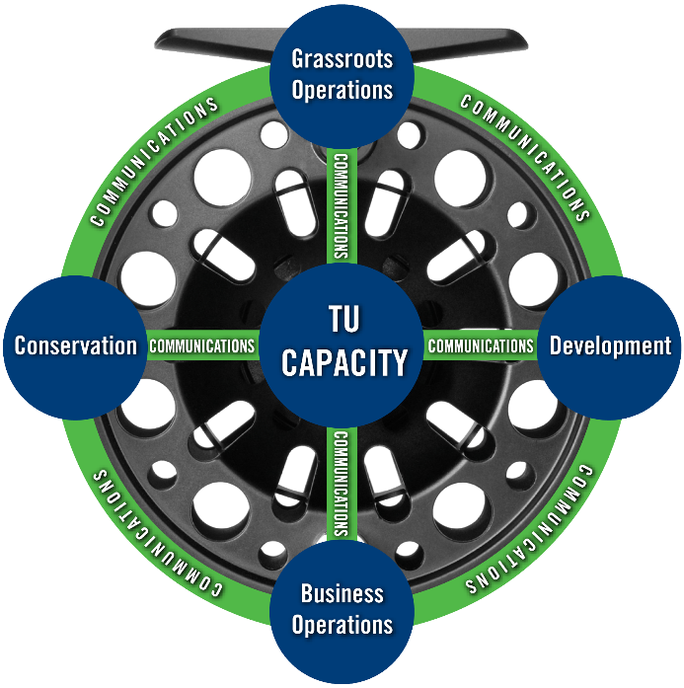
“Increase TU Capacity” to achieve the TU mission
Business Operations
Improve volunteer leader financial literacy through trainings
Increase effectiveness of chapter/council expense management
Increase use efficiency of resources (e.g., $$$)
Grassroots Operations
Analyze membership acquisition, engagement and retention
Enhance leadership skills for increased effectiveness
Increase clarity of leadership roles and expectations
Enhance staff support across more chapters and councils
Stronger leader succession planning
Enhance collaborative internal culture
Review NLC & TU organization and structure
Development
Increase development and training in best practices
Diversify revenue streams (e.g., donors, events, corporate sponsors, online, legacy gifts, etc.)
Conservation
Improve clarity of Protect, Reconnect, Restore, Sustain definitions to improve progress reporting
Increase the quantity of work through direct correlation to chapter and council development success
Increase volunteer expertise to remove limitations on quantity and scope (e.g., TU Science Team trainings)
Communications
Enhance internal and external communication
Improve consistency of messaging to donors, TU leaders, TU membership, general public & NGOs
Increase advocacy and name recognition
Improve identification and capture of target demographic(s)
Notes:
• At the September 2018 TU annual meeting (Redding, CA) the
NLC Grassroots Workgroup presented almost two (2) years of
work that was completed to identify what next steps the NLC
and TU needed to undertake to “Increase TU Capacity”.
• The “reel” identified five (5) key areas on which to focus:
- See slide for 5 areas
• These became the focus for the NLC 2019 Goals and
Objectives.
• See next slide…

Slide 3


NLC – 2019 Goals (Focus to Increase Capacity & Effectiveness)
Identify and Implement Processes to Increase TU Capacity
  Business Operations
  Conservation
  Development/Fundraising
  Grassroots Operations
Enhance Communications Throughout Trout Unlimited
Complete Assessment of Organization Efficiency
Increase Membership Engagement & Growth
Recruit, Mentor and Build Leadership Talent
Increase Involvement in Advocacy and Public Policy Issues
Strengthen Collaborations of BOT, Chapters, Councils, Members and Staff
Prepare for Strategic Plan Review
Notes:
• These were the focus for the NLC 2019 Goals
and Objectives.
• These should be familiar with the NLC
Representatives and Workgroup Chairs with their
involvement and leadership to make progress
and accomplish.

Slide 4
NLC Officer, Representatives & State Chairs – Conference Calls
January - March, 2019: NLC officer calls with each NLC Workgroup Chair (12)
April - September, 2019: NLC officer calls with each of 34 NLC Representatives and State Council Chairs
Several key questions:
  What are three BIG issues for your chapters & also for the council?
  Who is primarily responsible for “acquiring new members”?
  Who is primarily responsible for “engagement and retaining members”?
  What succession plans and training exist for leaders?
  Suggestions for enriching and improving the effectiveness of the NLC?
  Suggestions for enriching and improving the effectiveness of TU?
  Suggestions for NLC officers in leading the NLC?
Notes:
• Briefly, one of the first steps was to gather
information from throughout the councils,
chapters and members on what were
considered some “key” questions.
• Value was to prepare the NLC for developing
Goals and Objectives for 2020 and in
preparation for the upcoming 5-Year Strategic
Plan Review in 2020 – 2021 with the TU staff.

Slide 5
Feedback from Conference Calls - NLC Representatives & State Chairs
BIG challenges for Councils
  Educating membership on the relevancy, role and functions of the Council
  Recruiting members into leadership roles
  Educating members on the roles and responsibilities of being a Council leader
  Leadership training
  Leaders balancing personal lives with their leadership roles
  Engaging and managing chapters throughout a large geographic territory
  Quality and timely communications to chapters and members
  Enhance planning and succession planning to more formal processes
  Fundraising to increase programs
Notes:
• You will see there were many “common
issues” within the councils.
• Share several key issues.

Slide 6
Feedback from Conference Calls - NLC Representatives & State Chairs
BIG challenges for Chapters
  Attracting, engaging and retaining an active and diverse membership
  Recruiting members into leadership roles
  Leadership training
  Leaders balancing personal lives with volunteer roles
  Avoiding leaders burnout
  Fundraising to increase programs
  Improve communication to members (i.e. with no email address)
  Enhance planning and succession planning to more formal processes
Notes:
• You will see there were many “common
issues” within the chapters.
• Share several key issues.

Slide 7

Feedback from Conference Calls - NLC Representatives & State Chairs
Who is primarily responsible for “acquiring new members”?
  Unanimous (almost) that Chapters are/must be the leaders
  Members have more opportunities and must make more invitations
  Conservation is key – and has not been lost on young people.
  TU is a conservation organization – with members who like to fish!
Notes:
• You will see one very important response
(almost unanimous) – chapters are primary
responsible for acquiring new members into TU!
• Share several key reasons from slide.

Slide 8
Feedback from Conference Calls - NLC Representatives & State Chairs
Who is primarily responsible for “engaging and retaining members”
  Unanimous (almost) that Chapters are/must be the leaders
  The younger generation want to experience something new
  Dull meetings and not being welcomed will not bring and create an engaged member – personal engagement is required
  National communications are very much needed and support the need for local and state involvement
Notes:
• Again, you will see one very important response
(almost unanimous) - chapters are primary
responsible for engaging and retaining new
members into TU!
• Share several key reasons from slide.

Slide 9
Why Did You Join TU? (2016 Survey *)
* Survey 4,121 members; 363 chapters represented
Notes:
Survey designed by NLC Women’s Initiative Committee
Opened April, 2016
4,121+ responses
363 chapters represented in survey
Both males and females surveyed
Requests to complete: Lines to Leaders and chapter leadership requests
Survey closed at end of year 2016

Slide 10
Membership % by Age:
Average Age: In 2011: 59 years old | In 2019: 63 years old
Notes:
• On the chart you will see the average age of a
TU member has continually grown older – from
age 59 in 2011 to age 63 in 2019.
• In the slides ahead we will share one of many
membership challenges TU is facing.

Slide 11
Feedback from NLC State-by-State Conference Calls
Do succession plans exist in Council and Chapters?
  Various levels of planning exist
  Years of service fading as an entitlement to being named a leader
  Younger members avoid administrative leadership roles
  Larger organizations have more formal plans
  Smaller organizations have less planning…keeping activities and projects underway takes priority
Support needed by NLC Rep’s and State Chairs
  Materials and presentations that can be shared without much additional preparation
  Assistance in providing basic leadership training for chapter and council leaders
Notes:
• During the discussions, what challenges were
being faced on succession planning for
leadership of committees, boards and officer
positions.
• Share several key reasons from slide;
including:
- Younger members avoid administrative
leadership roles
- Members do not want to be committed
to attending boring meetings
• State leaders need assistance, materials and
tools on basic leadership for councils and
chapter leaders.

Slide 12
Strategic plan goal: “15 percent increase in leadership succession planning”
Notes:
Note the decrease of “new” leaders in 0 - 9 years!
Note the increase of “experienced” leaders retained in leadership roles in 10 – 15+ years.
0-4: FY15 = 1422 | FY16 = 1482 | FY17 = 1448 | FY18 = 1429
5-9: FY15 = 901 | FY16 = 909 | FY17 = 1016 | FY18 = 986
10-14: F15 = 421 | FY16 = 451 | FY17 = 452 | FY18 = 485
15+: FY15 = 395 | FY16 = 397 | FY17 = 381| FY18 = 403
2015: 3,139
2016: 3,239
2017: 3,270
2018: 3,308 (Increase of 169 leaders (5%) from 2015)
Overall very similar year over year and perhaps not a great indicator of the stated goal.

Slide 13
NLC Feedback – Improving the Effectiveness of the NLC
Suggestions to improve the effectiveness of the NLC
  Continue to communicate:
    - What is the NLC and how it relates to TU organization
    - What the NLC does for TU, councils and chapters
  - Increase awareness throughout TU; in the past never hear about
  (or from) the NLC
  Review organization structure – relevance of some workgroups
  Recruit State Council Chairs to participate in workgroups
  Integrate workgroups into state councils activities
  Provide and strengthen leadership training
  Provide process to share Chapter and Council Best Practices
  Create membership promotional programs with TU staff
  Consider web conferencing for meetings of NLC and Workgroup meetings
Notes:
Some suggestions included:
• Continue providing timely and informative
communications as soon as possible.
• Review the relevance of some NLC workgroups.
• Continue the involvement of State Council Chairs
in communications and planning.
• Develop programs to promote acquiring new
members and retaining current members.

Slide 14
NLC Feedback – Enriching the TU Organization
Suggestions for enriching the TU organization
  Increase understaffed Volunteer Operations organization
  Adapt communication and media to younger members
  Evaluate effectiveness on the frequency and the type of member mailings
  Include critical issues and educational topics in appropriate mailings for renewals and fundraising requests
  Promote focus on habitat and climate change that impacts all anglers
  Encourage and support NLC Representatives, State Council Chairs and Board of Trustees to attend state, regional and
  annual meetings
Notes:
Some suggestions included:
• Unanimous feedback: Find ways to increase the
Volunteer Operations organization!
• Share other suggestions as time permits.

Slide 15
NLC Feedback – Leading the NLC
Suggestions for NLC officers in leading the NLC
  Continue outreach with councils and workgroups
  Set and communicate expectations
  Increase frequency of orientation sessions for new NLC leaders and State Council Chairs
  Consider use of online video conferencing for meetings of NLC and Workgroup meetings
  Attend as many state, regional and national meetings as possible
  Communicate the achievements of the NLC and NLC leaders – celebrate our successes
Notes:
Some suggestions for the NLC Chair and Secretary included:
• Continue outreach and the providing of timely and
informative communications.
• Set and communicate expectations for the
workgroups and states.
• Attend as many local, state and regional meetings
as possible.
• Share other suggestions as time permits.

Slide 16
Priorities Come From The Vision and Strategic Plan
National Conservation
Agenda *
Strategy &
Business Plan
Objectives
Develop Action Plan
Measures
Identify Measures of Progress
When results are measured,
results improve!
Initiatives
Identify / Develop Programs for Improvement
Targets
Assess Current Performance & Set Targets
* Chapters, Councils, NLC, TU staff
Notes:
In developing the NLC Goals and Objectives for 2020:
• In setting and communicating expectations for the NLC, we plan
to go through a more formal process – especially in tracking our
progress and successes.
• Starting with the developing the National Conservation Agenda
(NCA) with the Critical Focus Areas (CFAs), the NLC and TU
staff will initiate discussions on the 5-Year Strategic Plan.
• Share the next steps within the slide; focus are resources on
what needs to be done!
• Research has shown: “When results are measured, results
improve!”

Slide 17

NLC – 2020 Business Plan
Enhance Communications Throughout TU
Identify and Implement Processes to Increase TU Capacity
  - Business Operations
  - Conservation
  - Development/Fundraising
  - Grassroots Operations
Continue Assessment of Organization Efficiency
Increase Membership Engagement & Growth
Recruit, Mentor and Build Leadership Talent
Increase Involvement in Advocacy and Public Policy Issues
Strengthen Collaborations of BOT, Chapters, Council, Members and Staff
Develop Goals, Objectives and Measurements with Accountability of Results
Create and Communicate a Strategic Vision
Champion Strategic Plan Review
October 2019 (Title) (?)
Notes:
Looking ahead to develop the NLC Goals and Objectives for 2020:
• Much of what we had in 2019 - with specific
initiatives to be defined and refined with the
NLC Workgroups and the TU staff.

Slide 18
Focus on Achieving Our Future
Mission
To conserve, protect and restore North America's coldwater fisheries and their watersheds.
Vision
By the next generation, Trout Unlimited will ensure that robust populations of native and wild coldwater fish once again thrive within their North American range, so that our children can enjoy healthy fisheries in their home waters.
Notes:
Finally, IF we become more focused on where to use our resources (funding, staff and volunteers) the better we will become to achieve our Mission and Vision.
Thanks for listening.
Any questions or comments?

