Slide 1
Climate ChangeTools and Response
2023 Regional Rendezvous
Taos, New Mexico

Slide 2
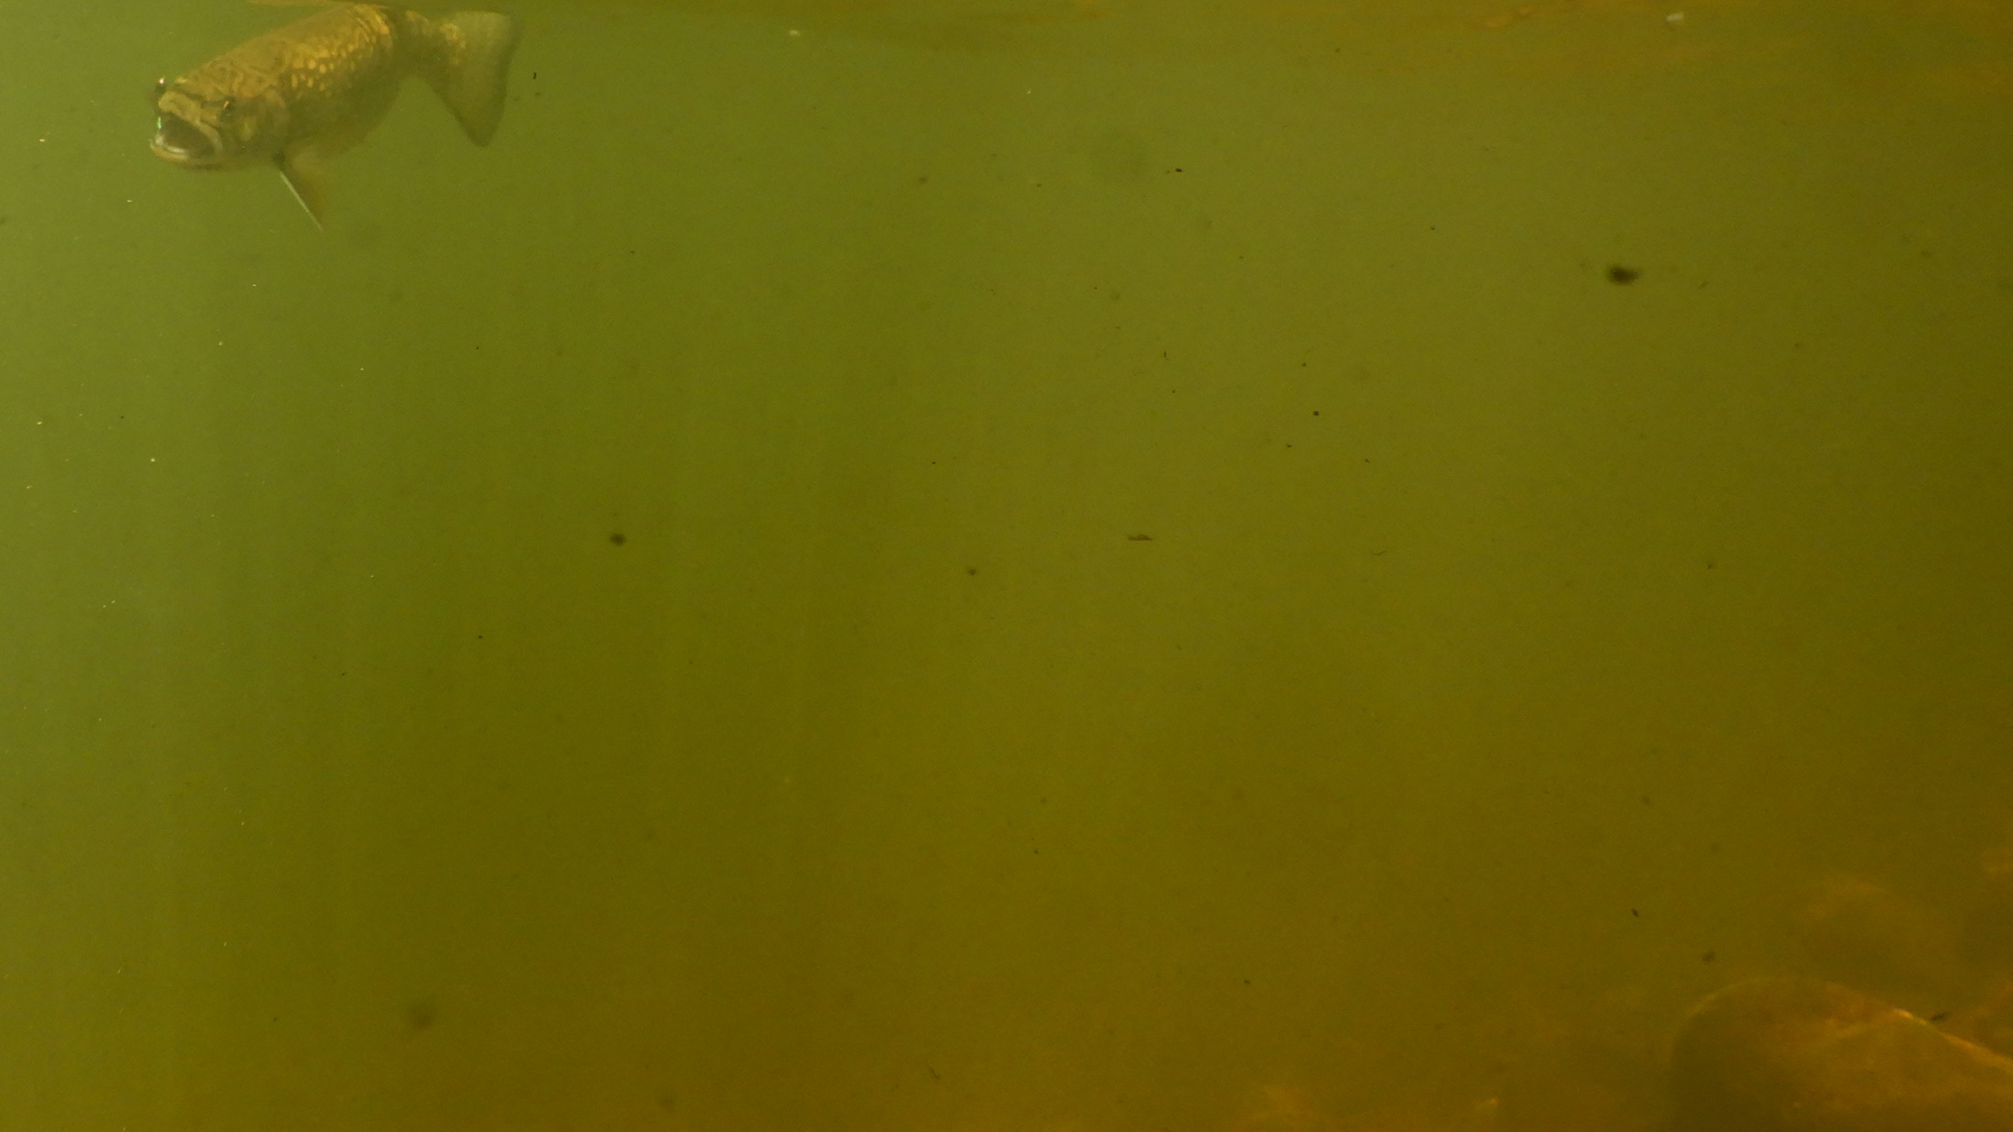

Agenda
  Why Become a Climate Change Coordinator.
  Responsibilities of Climate Change Coordinator.
  Actions Climate Change Coordinators can coordinate.
  Contact information for volunteering as coordinator.

Slide 3
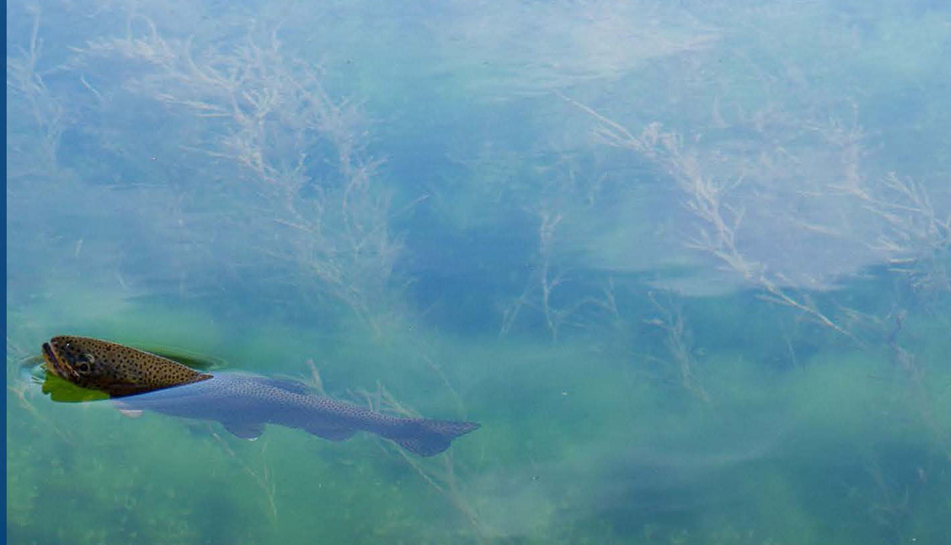
Why Become a Climate Change Coordinator?
To protect native trout, wild trout, salmon and their watersheds from the impacts of climate change by:
    Designing projects to slow the harmful effects of temperature and rainfall extremes.
    Incorporating climate change into your chapter’s strategic plan.
    Promoting angler science— stream temperature and flow monitoring.
    Discussing climate change with legislators during stream walks or in-district visits.
    Nonpartisan anglers’ voice on climate change adaptation and mitigation.

Slide 4
Why Become a Climate Change Coordinator?
To help your chapter or council plan projects to address climate change, such as:
    Improving climate change education/awareness messaging based on best available science.
    Positioning TU as a nonpartisan anglers' voice on climate change adaptation and mitigation.
    Encouraging non-traditional members to join TU.

Slide 5
Primary responsibility:
Communicate consistent TU science based message to raise awareness or to advocate for a Trout Unlimited position.
Stay current on TU national climate change policies and keep chapters/councils informed
Coordinate education and local non-partisan advocacy for members and the public on local support for policies and bills.
Good communication skills and a basic understanding of climate change are beneficial.
Climate change can be divisive so be respectful of other’s opinions.

Slide 6
Become familiar with and share:
Tools and resources on the Climate Change Workgroup page.
Science on emissions from burning fossil fuels, alternatives to fossil fuels, and proposals to help transition from fossil fuel to low carbon energy alternatives.
Coordinate with the following volunteer and climate change resources:
    NLC Climate Change Workgroup
    Volunteers Ops (Beverly Smith, Jeff Yates, Maggie Human)
    Science staff (Helen Neville)

Slide 7
Actions:
Communicate climate change awareness at the council/chapter “grassroots” level.
Coordinate with Conservation Chairs to design habitat projects that incorporate measures to slow climate change and adapt to temperature and rainfall extremes.
Foster communication between Climate Change Working Group and councils & chapters.
Provide contacts for questions, tools, tips, and climate change facts.
.

Slide 8
Actions 2:
Engage in streamside conversations about the impact of higher temperatures, flooding and drout on fishing.
Organize a stream tour/fishing event incorporating climate discussion for elected officials.
Participate in monthly Climate Change Work Group calls.
.

Slide 9
One More Action to Consider:
Consider partnering with organizations, such as Citizens’ Climate Lobby, to promote climate legislation to reduce emissions and preserve coldwater fisheries by:
  Advocating,
  Making presentations,
  Calling legislators,
  Writing op-eds and letters to the editor.

Slide 10
Become a Climate Change Coordinator
To serve as a Climate Change Coordinator or join the Workgroup:
      Contact Jeff Holzem, Jeff 2002h@ yahoo.com or
      Russ Collins, Russ@dftu.org.
      To learn more, check out the Workgroup's web page:
      Climate Change Workgroup - National Leadership Council - Trout Unlimited
bit.ly/3YVkzPA

