Slide 1


Slide 2
Roadmap for Today's Presentation
What is "normal" in the realm of nonprofits and tax-exempt orgs?
What do folks expect to see when proving tax-exempt status?
What is a group exemption?
How TU chapters & councils are exempt under TU's group exemption.
How to show proof of your chapter or council's tax-exempt status.
What 501(c)(3) status is NOT.
Contact Information & Resources

Slide 3


What is "normal" in the world of tax-exempt orgs?
Incorporated in the primary state in which they operate (only ~25% of chapters/councils incorporated).
No Affiliation—no "parent" or "central" organization they are affiliated with.
Determination Letter issued by the IRS (on IRS letterhead).

Slide 4
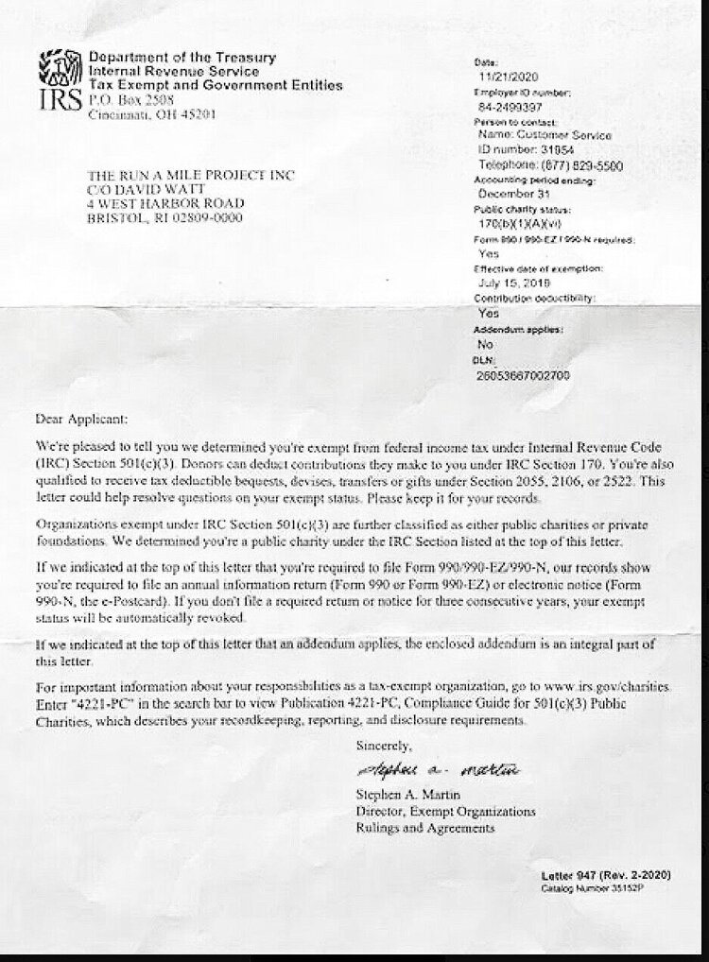
What do folks expect to see when proving tax-exempt status?
VAST majority of tax-exempt organizations apply for their own TE status.
When successful, the IRS will issue a "Determination Letter" on IRS letterhead.
  Indicates under what section of the IRC the org is exempt (most commonly, 501(c)(3)).
Shows effective date of exemption.
Also includes "public charity status."

Slide 5
What is a Group Exemption?
Group exemptions are EXTREMELY rare, particularly outside the context of religious organizations.
IRS recognition of tax-exempt status for a group of organizations, as long as they're affiliated with a "central organization."
"Subordinate organizations" (e.g. chapters & councils) affiliated with the central organization don't have to separately apply for TE status.
Criteria for Subordinate inclusion in group exemption:
  Affiliated with central organization;
  Subject to the central organization's general supervision or control;
  Exempt under same paragraph of IRC 501(c).
Fun Fact: The IRS has not issued group exemptions in several years. TU's group exemption is one of its most important assets!

Slide 6
How TU Chapters & Councils are Exempt under TU's Group Exemption
When chartered, chapters & councils authorize TU to include the org. in TU's group exemption, eliminating the need for the chapter to apply on its own.
Chapters & Councils must adhere to the same exempt purposes as TU National, driving our mission forward.
Chapters & Councils submit Annual Activity Reports to keep National apprised of financial activity, volunteer hours, # of directors, etc.
Chapters & Councils are subject to TU's bylaws, policies, and procedures.

Slide 7

How to Show Proof of Chapter / Council Tax-Exempt Status
Provide "Letter of Good Standing" from TU National
  Shows chapter name, address, and EIN as listed with IRS and states the chapter is in good standing with TU National.
  Request from Q Collins (q.collins@tu.org) or Nick Halle (nick.halle@tu.org)
  Provide this instead of an IRS Determination Letter.
Provide copy of 990 filing for most recent fiscal year
  Proof of having filed information return with IRS for 501(c)(3) orgs.
  If 990-N filer, copy available in "Electronic Documents" within LOS.
  If 990-EZ or 990 filer, ask your Treasurer (and always upload to LOS)

Slide 8
SAMPLE: Letter of Good Standing

Slide 9

What 501(c)(3) Status is NOT
501(c)(3) status means the org is exempt from federal income tax.
501(c)(3) status is NOT...
  Incorporation in your state (specific req's);
  Charity Registration (req'd in 39 states);
  Sales Tax Exemption (varies state-to-state); or
  Real Property Tax Exemption (varies state-to-state);
    ALL OF THESE MUST BE COMPLETED SEPARATELY.

Slide 10
HELPFUL RESOURCES TO REFERENCE
IRS Publication 4573: Group Exemptions
  This is an awesome resource. It lays out how third-parties can verify a subordinate organization (e.g. chapter or council) is included in a group exemption and that contributions are deductible.
IRS Revenue Procedure 80-27
  High-level overview of group exemption rules & procedures.
IRS Publication 557: Tax-Exempt Status for Your Organization
  Wholistic guide covering many of the rules and regulations that apply to tax-exempt organizations; group exemption information at pages 8-9.
As always, please do not hesitate to reach out to Q Collins (q.collins@tu.org), TU's Volunteer Governance & Reporting Manager if you have any questions or concerns!

Slide 11

Questions?
Notes:
Both

