Slide 1
How Trace Gasses Can Change Climate
Mark van Roojen
11/15/2022
How Trace Gasses Can Change Climate by Mark van Roojen is licensed under CC BY-SA 4.0. To view a copy of this license, visit http://creativecommons.org/licenses/by-sa/4.0/

Slide 2
How variation in a small percentage of atmospheric gas significantly changes mean planet temperature:
The basic story involves several interacting scientific principles governing the transfer and transportation of energy and radiation:
  The inverse square law governing light and electromagnetic radiation.
  The reflectance, transmission and absorption properties of gases with respect to light at different wavelengths.
  The reflectance also of various surfaces including that of water and landmasses.
  The principles regarding the relationship between bodies at a given temperature and the wavelengths of radiation they give off.

Slide 3
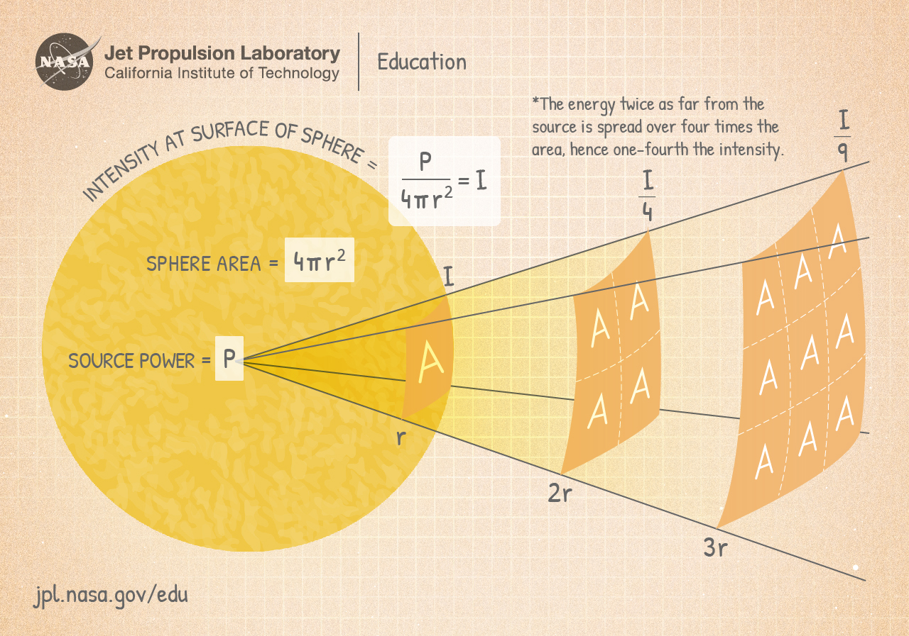
Radiant energy obeys an inverse square law: The amount of energy per unit of area is inversely proportional to the square of the distance from the source
Chart from NASA at https://www.jpl.nasa.gov/edu/images/activities/inverse_square_law.jpg

Slide 4
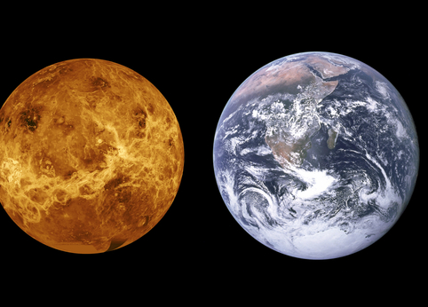
You would therefore expect the hottest planets to be closest to the sun from Mercury to Venus to Earth to Mars.
Public domain photo by NASA via
https://www.goodfreephotos.com

Slide 5

But you would have to adjust your predictions somewhat to take into account the different reflectances of the planet surfaces.

Slide 6
Predicted planetary mean temp.
S_{ave} is a measure of the average light intensity at the planet’s surface α = Albedo = a measure of reflectance
(from American Chemical Society web page at https://www.acs.org/content/acs/en/climatescience/energybalance/predictedplanetarytemperatures.html )
Planet | Mercury | Venus | Earth | Mars
S_{ave,} in Watts/Meter² | 2290 | 662 | 342 | 145
α = Albedo = a measure of reflectance | .10 | .75 | .30 | .25
Predicted Temperature Celsius | 163⁰C | -41⁰C | -18⁰C | -64⁰C
Notes:
The higher reflectance of Venus explains why it is predicted to be colder than earth despite being closer to the sun.

Slide 7
But that isn’t what we get.
Predicted planetary mean temp. vs. actual
S_{ave} is a measure of the of the average light intensity at the planet’s surface. α = Albedo = a measure of reflectance
(from American Chemical Society web page at https://www.acs.org/content/acs/en/climatescience/energybalance/predictedplanetarytemperatures.html )
Planet | Mercury | Venus | Earth | Mars
S_{ave,} in Watts/Meter² | 2290 | 662 | 342 | 145
α = Albedo = a measure of reflectance | .10 | .75 | .30 | .25
Predicted Temperature Celsius | 163⁰C | -41⁰C | -18⁰C | -64⁰C
Observed Temperature Celsius | 167⁰C* Because Mercury has no atmosphere this number is not directly comparable but an average of large swings | 462⁰C | 15⁰C | -58⁰C

Slide 8
Something has been left out and that is the effects of having an atmosphere.
S_{ave} is a measure of the of the average light intensity at the planet’s surface. α = Albedo = a measure of reflectance
(from American Chemical Society web page at https://www.acs.org/content/acs/en/climatescience/energybalance/predictedplanetarytemperatures.html )
Planet | Mercury | Venus | Earth | Mars
S_{ave,} in Watts/Meter² | 2290 | 662 | 342 | 145
α = Albedo = a measure of reflectance | .10 | .75 | .30 | .25
Predicted Temperature Celsius | 163⁰C | -41⁰C | -18⁰C | -64⁰C
Observed Temperature Celsius | 167⁰C* Because Mercury has no atmosphere this number is not directly comparable but an average of large swings | 462⁰C | 15⁰C | -58⁰C

Slide 9
Black Body Radiation: Oversimplified Explanation – no atmosphere
Bodies radiate energy at different wavelengths correlated with temperature.
Hotter bodies radiate shorter wavelengths.
Colder bodies radiate longer wavelengths.
The Sun radiates shorter wavelength light than the planets it warms.
The amount of energy reaching a planet as short wavelength light and the amount going out as longer wavelength light at some point reach equilibrium creating a relatively stable average temperature for the planet. The the planet heats up to the point where energy coming in equals energy going out.
The sun is much hotter than the earth and other planets

Slide 10
Oversimplified Explanation – atmosphere added
Bodies radiate energy at different wavelengths correlated with temperature.
Hotter bodies radiate shorter wavelengths.
Colder bodies radiate longer wavelengths.
The Sun radiates shorter wavelength light than the planets it warms.
- Some planets have atmospheres that are transparent to shortwave radiation but not to long wave radiation. The energy of the trapped radiation heats the planet to a temperature higher than it would be without an atmosphere. The planet heats up until it emits enough radiation to once again radiate out as much as it takes in.
The sun is much hotter than the earth and other planets
These planets will be warmer than you would predict using just black body radiation estimates.

Slide 11
Predicted planetary mean temp. vs. actual
S_{ave} is a measure of the intensity of the average light intensity α = Albedo = a measure of reflectance
(from American Chemical Society web page at https://www.acs.org/content/acs/en/climatescience/energybalance/predictedplanetarytemperatures.html )
Planet | Mercury | Venus | Earth | Mars
S_{ave,} in Watts/Meter² | 2290 | 662 | 342 | 145
α = Albedo = a measure of reflectance | .10 | .75 | .30 | .25
Predicted Temperature Celsius | 163⁰C | -41⁰C | -18⁰C | -64⁰C
Observed Temperature Celsius | 167⁰C* Because Mercury has no atmosphere this number is not directly comparable but an average of large swings | 462⁰C | 15⁰C | -58⁰C
Notes:
And that basically explains why we get the variance between predicted mean temperature and actual mean temperature for these planets.

Slide 12
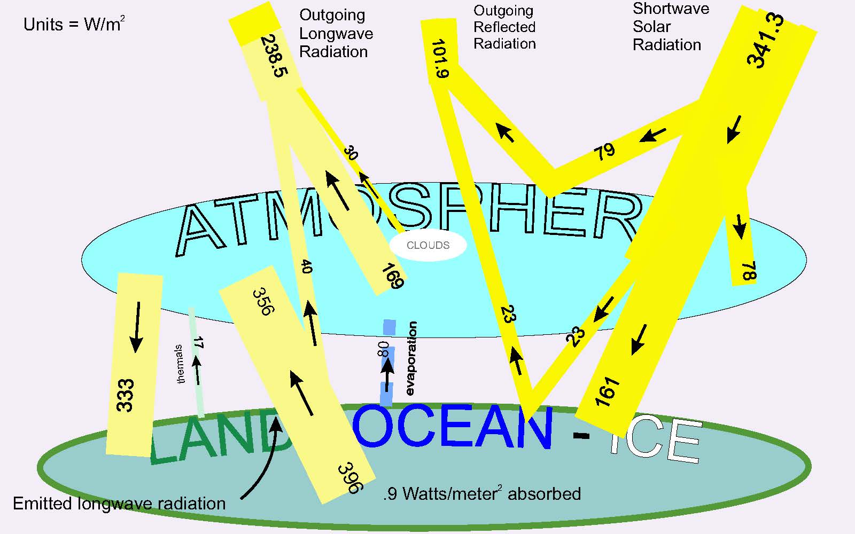
When a planet’s average temperature is stable the amount coming in and the amount going out as radiation from all sources will be equal.
Information presented here and the basic idea of the graphic presentation is taken from
Kevin E. Trenberth, John T. Fasullo, and Jeffrey Kiehl, EARTH’S GLOBAL ENERGY BUDGET, Bulletin of the American Meteorological Society (March 2009) https://doi.org/10.1175/2008BAMS2634.1
There is a similar image from NASA at https://www.nasa.gov/sites/default/files/thumbnails/image/ceres-poster-011-v2.jpg
Notes:
The large bar with arrows pointed down represents incoming energy from the sun. The bars with arrows going up represent energy reflected or emitted from the land, ice and ocean on the earth’s surface and from the atmosphere.

Slide 13
Energy leaving the Earth as radiation comes from both the surface and the atmosphere.
Information presented here and the basic idea of the graphic presentation is taken from
Kevin E. Trenberth, John T. Fasullo, and Jeffrey Kiehl, EARTH’S GLOBAL ENERGY BUDGET, Bulletin of the American Meteorological Society (March 2009) https://doi.org/10.1175/2008BAMS2634.1
There is a similar image from NASA at https://www.nasa.gov/sites/default/files/thumbnails/image/ceres-poster-011-v2.jpg

Slide 14
Note that much of the energy radiating back out from the earth is either absorbed or reflected back by the atmosphere.
Information presented here and the basic idea of the graphic presentation is taken from
Kevin E. Trenberth, John T. Fasullo, and Jeffrey Kiehl, EARTH’S GLOBAL ENERGY BUDGET, Bulletin of the American Meteorological Society (March 2009) https://doi.org/10.1175/2008BAMS2634.1
There is a similar image from NASA at https://www.nasa.gov/sites/default/files/thumbnails/image/ceres-poster-011-v2.jpg
Notes:
The large bar with arrows pointed down represents incoming energy from the sun. The bars with arrows going up represent energy reflected or emitted from the land, ice and ocean on the earth’s surface and from the atmosphere.

Slide 15
Earth’s Atmosphere
Nitrogen (78.08%)
Oxygen (20.95%)
Argon (0.93%)
Water vapor (varies at around 0.25% by weight)
Trace gasses: carbon dioxide (0.04%), methane, ozone, nitrous oxide, hydrogen, helium, other noble gasses.

Slide 16
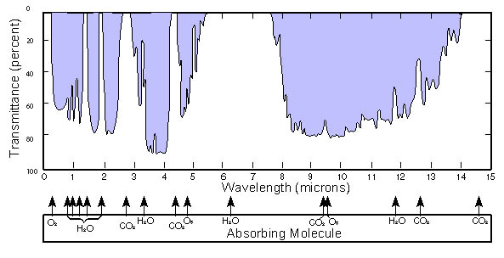
Atmospheric Transparency/Opacity
White areas represent wavelengths at which atmosphere is less transparent
Public Domain, https://commons.wikimedia.org/w/index.php?curid=34818020 (US Navy generated image edited to flip on horizontal axis)
Visible light comes through here.
Notes:
Our atmosphere has varying transparency to different wavelengths of light because of the gasses it is composed of, most importantly water vapor. Average atmospheric water vapor increases with warming.

Slide 17
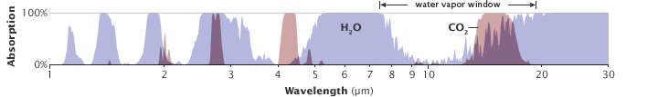
Image from from NASA page at https://earthobservatory.nasa.gov/Features/EnergyBalance. They write: “The absorption patterns of water vapor (blue peaks) and carbon dioxide (pink peaks) overlap in some wavelengths. Carbon dioxide is not as strong a greenhouse gas as water vapor, but it absorbs energy in wavelengths (12-15 micrometers) that water vapor does not, partially closing the “window” through which heat radiated by the surface would normally escape to space.” They say they adapted an image from Robert Rhode.
IR Absorption of CO₂ vs. H₂O
CO₂ blocks light that water vapor would let through
Notes:
Note that meaning of vertical axis has reversed from the previous slide. White areas are more transparent.

Slide 18
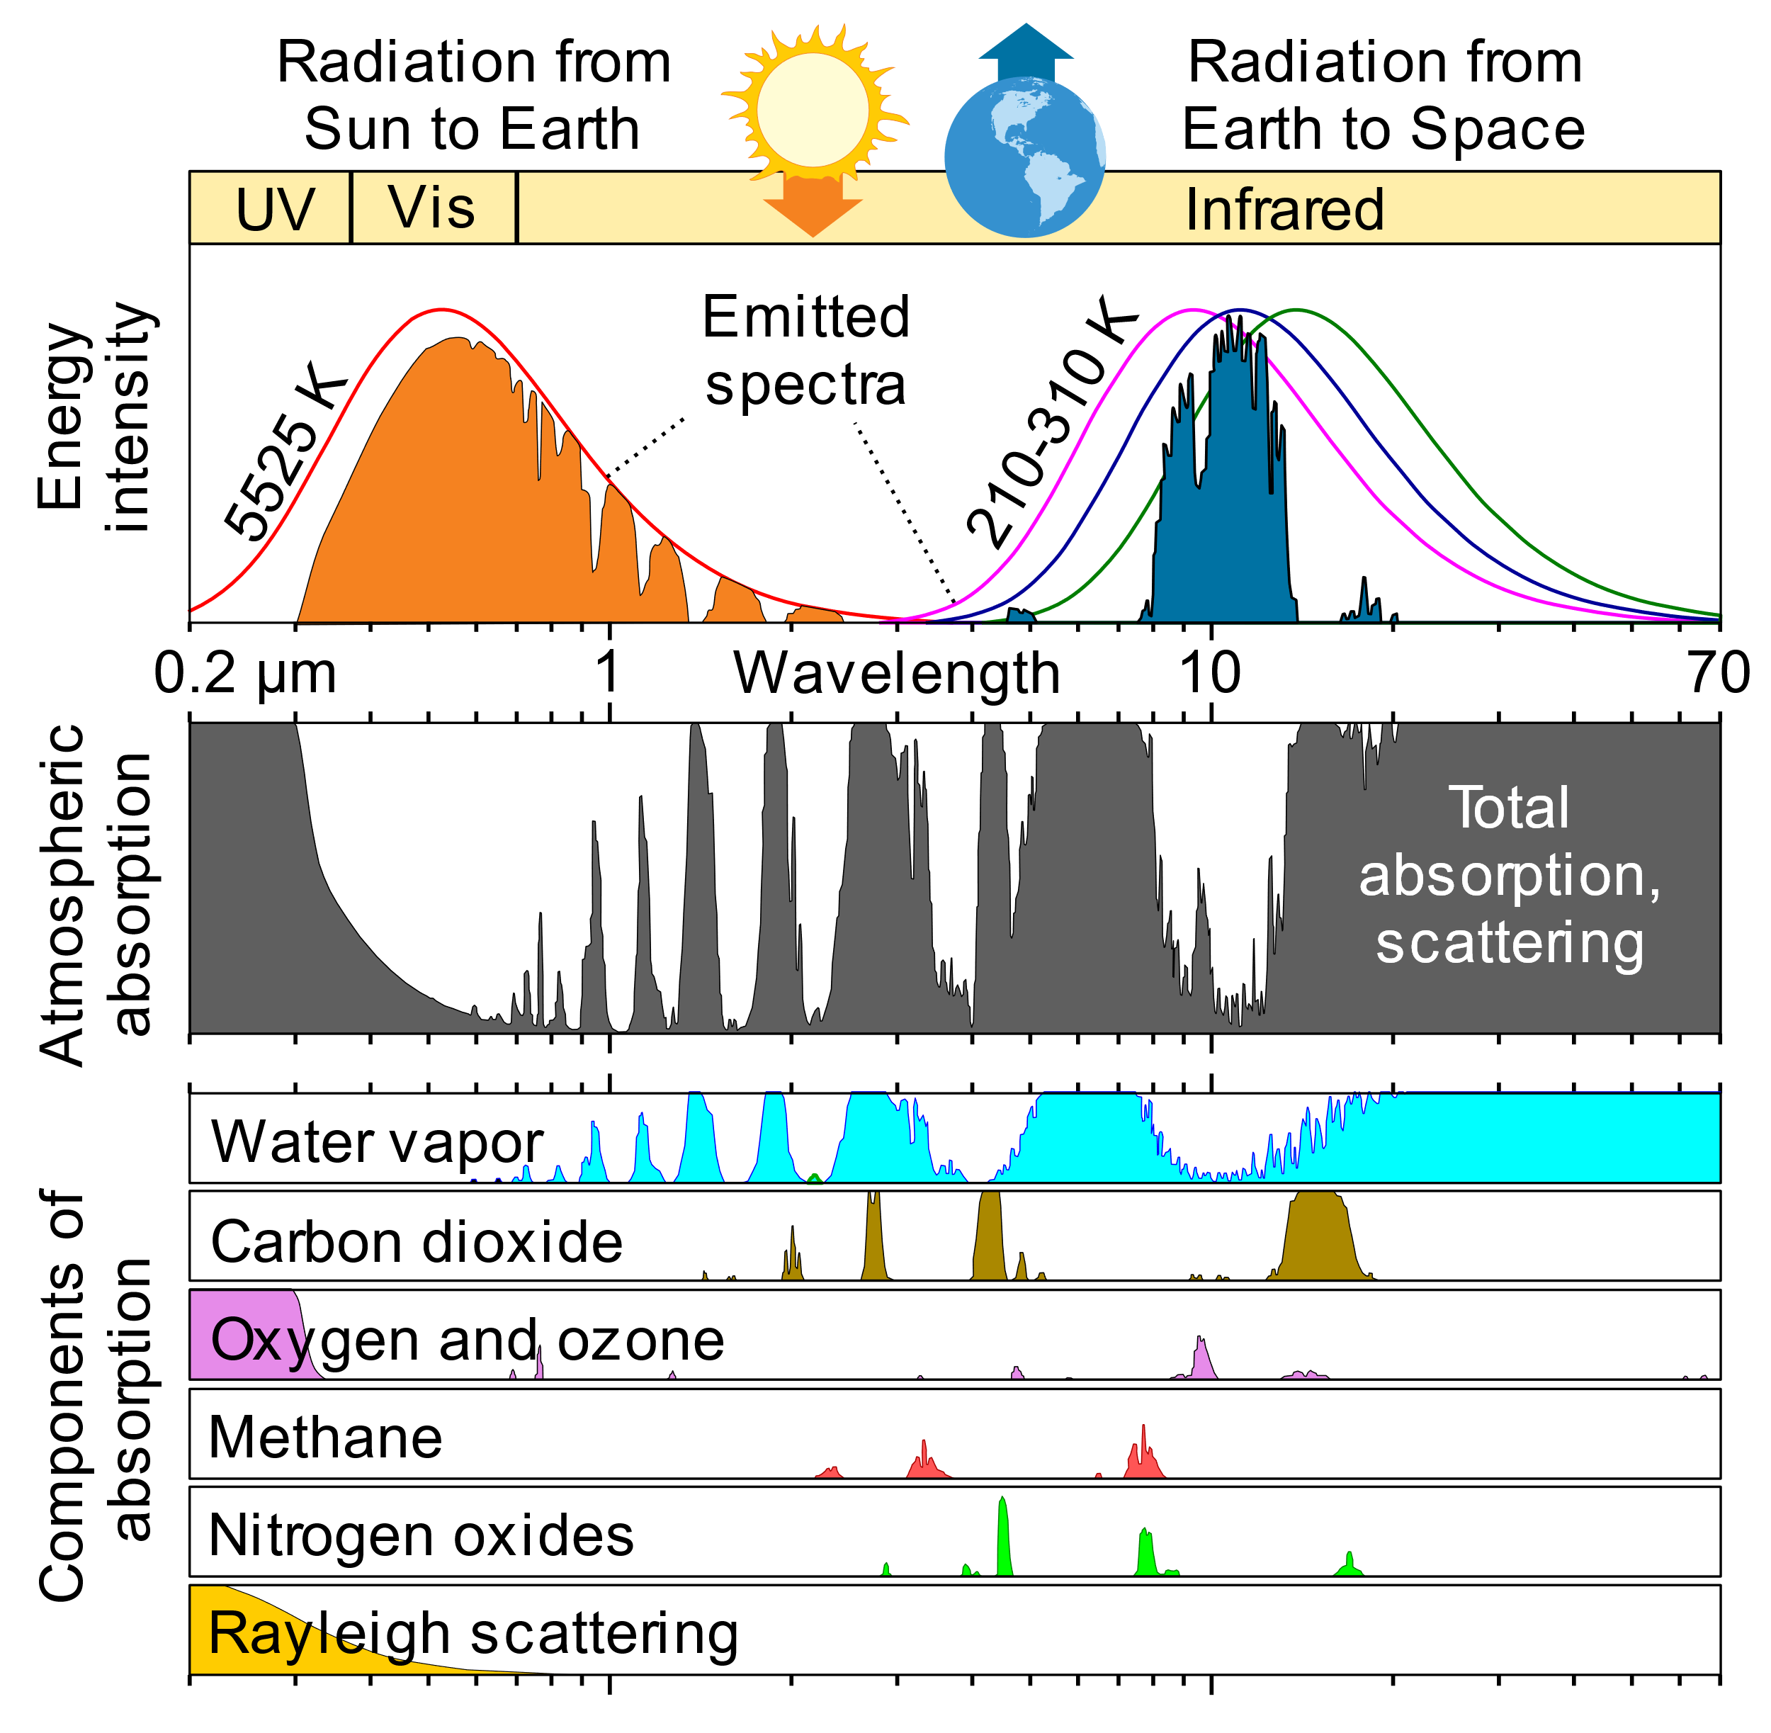
Other gasses besides CO2 and water vapor also matter.
This figure was prepared by Robert A. Rohde for the Global Warming Art project and made available under the Creative Commons CC0 1.0 Universal Public Domain Dedication. It was downloaded on Nov 18, 2022 from https://commons.wikimedia.org/wiki/File:Atmospheric_Transmission.svg
Notes:
This chart adds absorption information about other atmospheric gasses and their cumulative effect. Methane is another important Greenhouse gas whose absorption high points partly overlap with other gasses but still has significant effects, especially in the near term. (It breaks down more quickly than CO2 so over the longer term it has less effect.)

Slide 19
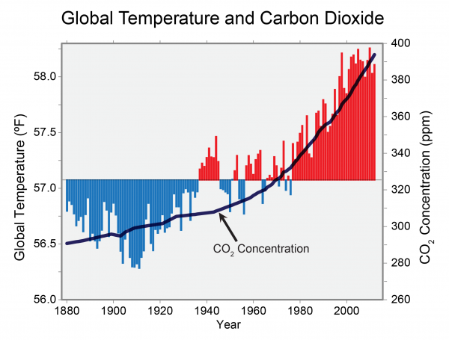
Correlation between observed average global temperature and CO₂ concentration
Blue = below average & red = above average temps
Chart from US Government website, https://www.globalchange.gov/browse/multimedia/global-temperature-and-carbon-dioxide (figure updated from Global Climate Change Impacts in the United States, Thomas R. Karl, Jerry M. Melillo, and Thomas C. Peterson, (eds.). Cambridge University Press, 2009.)
Notes:
This chart maps observed average temperatures for a 140 year period onto atmospheric CO2 concentrations in parts per million.

Slide 20
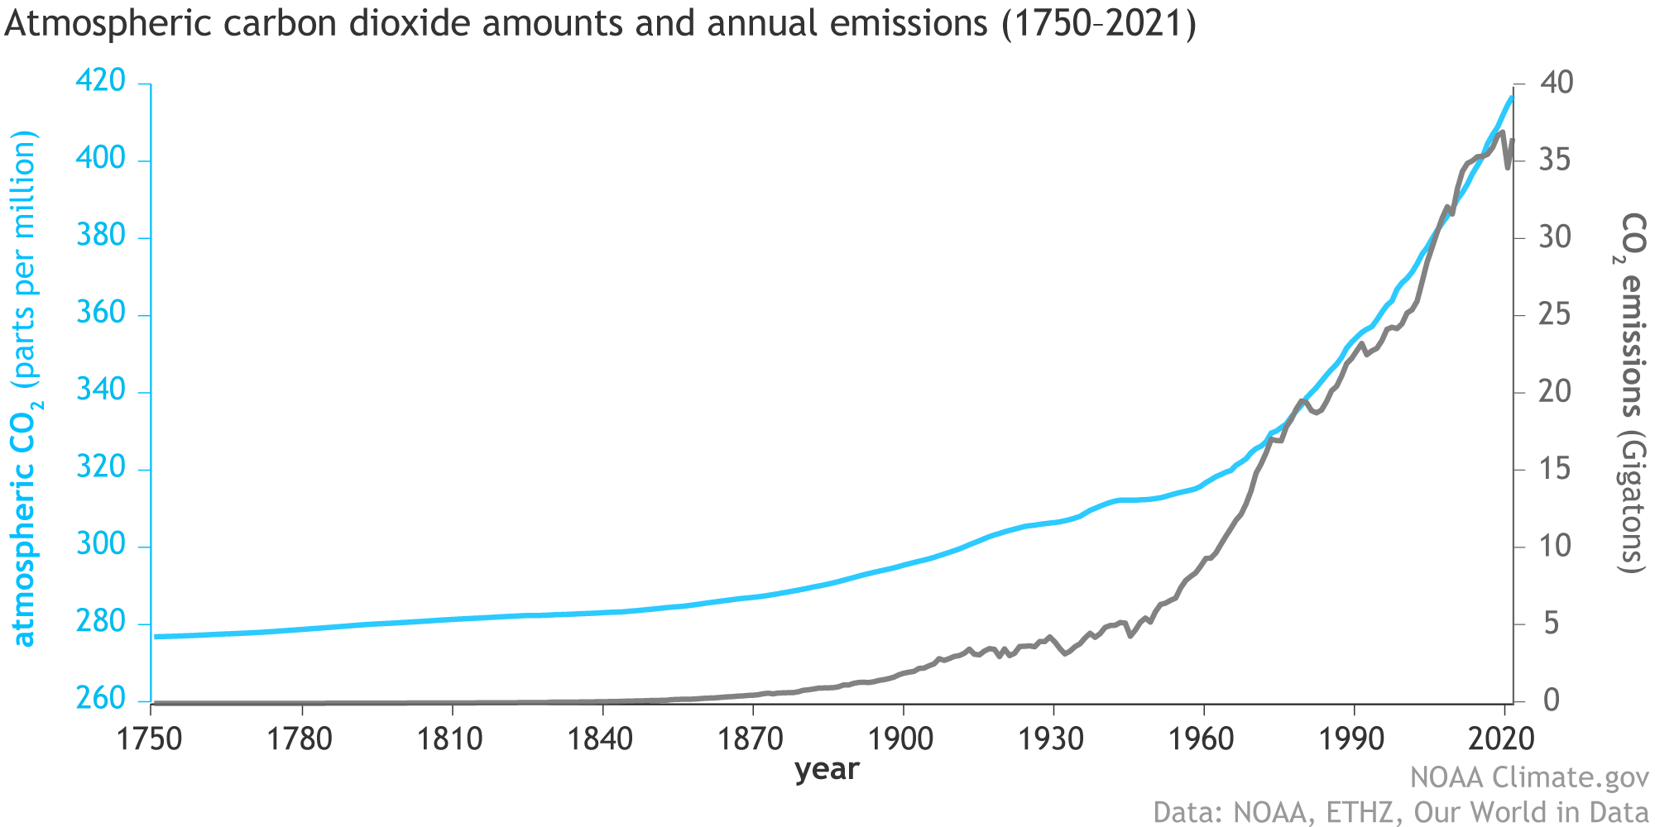
Atmospheric CO₂ Concentrations and Annual Emissions over time.
Chart from US Government website, https://www.climate.gov/media/14596 (NOAA Climate.gov graph, adapted from original by Dr. Howard Diamond (NOAA ARL). Atmospheric CO₂ data from NOAA and ETHZ. CO₂ emissions data from Our World in Data and the Global Carbon Project.)
Notes:
This chart maps overall CO2 as well as emissions leading to an increase in CO2 over the course of the industrial revolution.

Slide 21
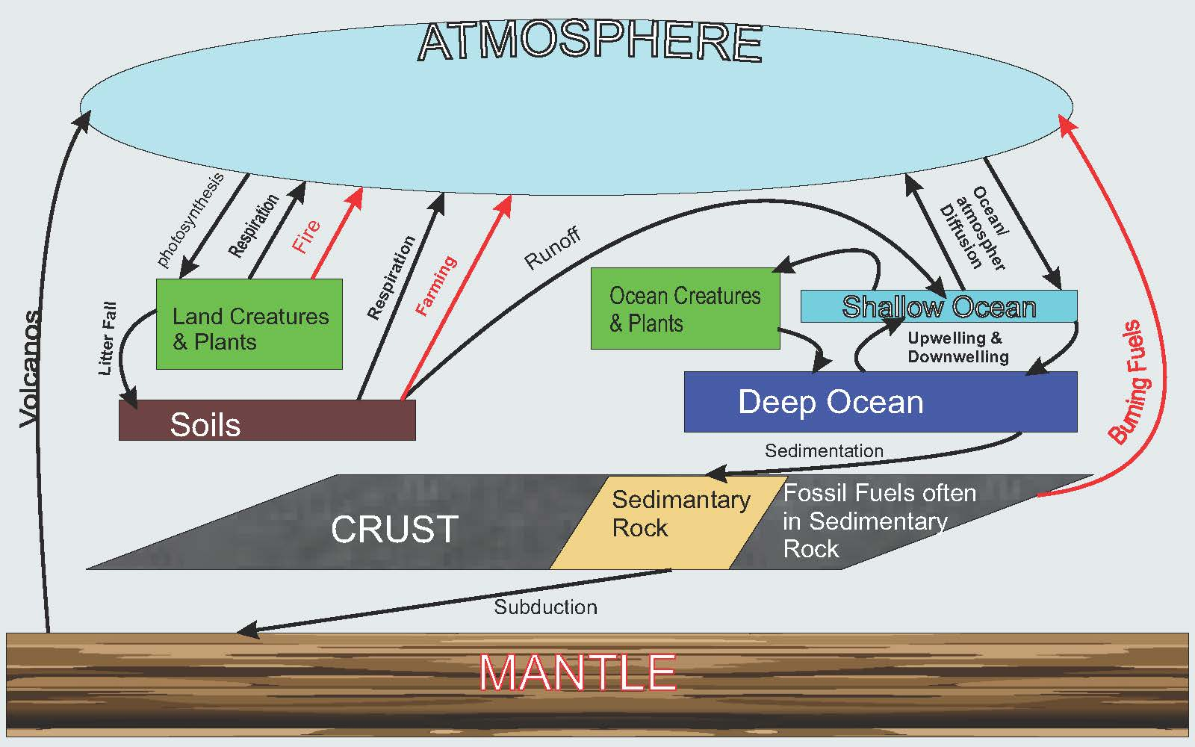
Carbon Cycle Schema
Information and basic organizing idea of chart from David Bice, Professors of Geosciences, College of Earth and Mineral Science, The Pennsylvania State University (© Penn State University licensed under CC BY-NC-SA 4.0), found at https://www.e-education.psu.edu/earth103/node/1019 on 9/17/2020
Notes:
Arrows in red are subject to human influence. Arrows in black are not as much so.

Slide 22
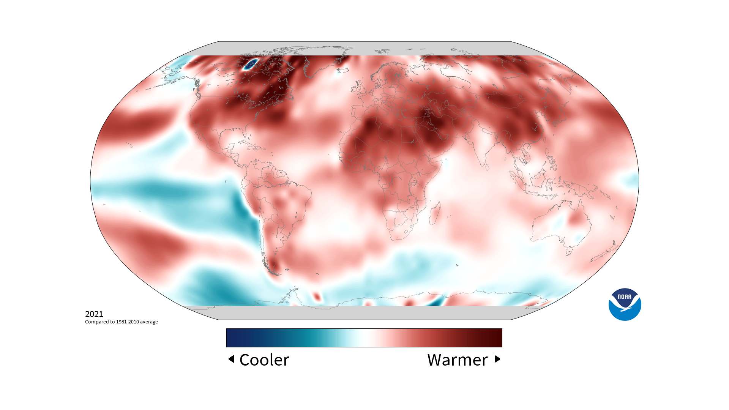
2021 temperatures compared to average of 1981 to 2010
Image from set of images available for public use at climate.gov. This one is at: https://www.climate.gov/data/Temperature--Yearly--Difference-from-average--Global/03-broadcast/Temperature--Yearly--Difference-from-average--Global--2021-00-00--broadcast.png

